Slide 1


Slide 2
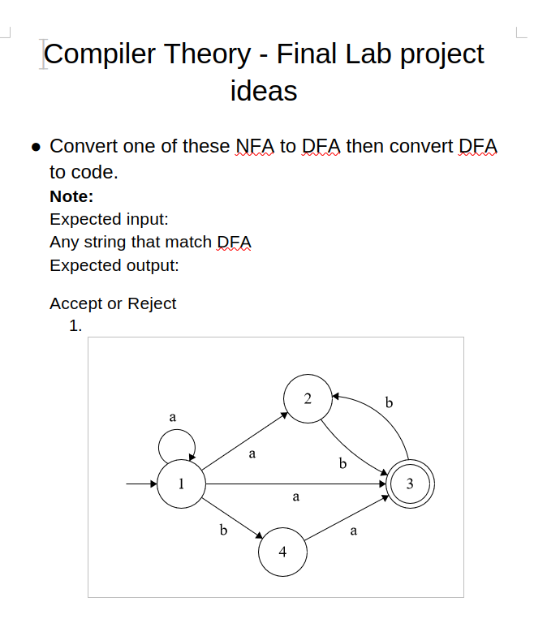

Slide 3
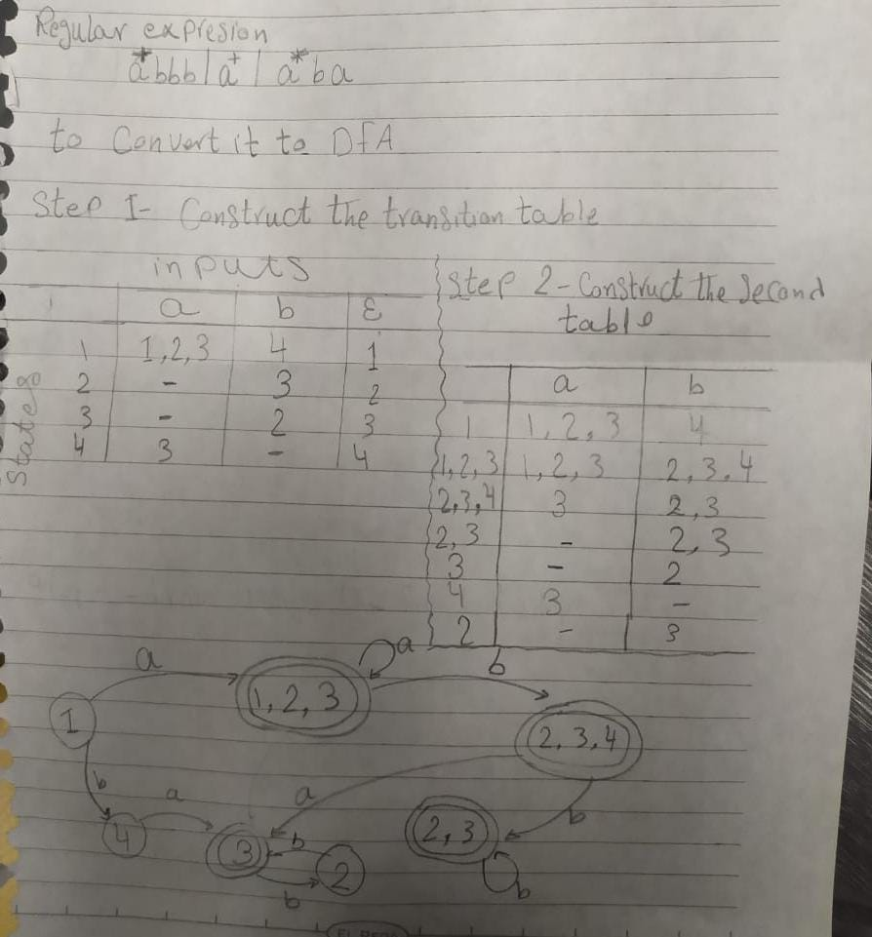

Slide 4
"I will provide the code in the repository. There was a logic error when I was programming it
in assembly. I redrew the automaton to have it available while programming,
but this time I mistakenly used 'b' instead of 'a'."
B

Slide 5
Here are some challenges I faced while programming with assembly

Slide 6
Problem 3

Slide 7
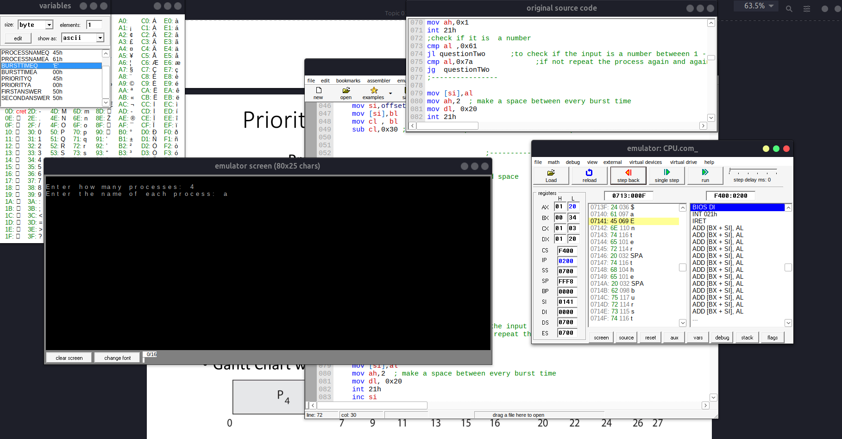

Slide 8
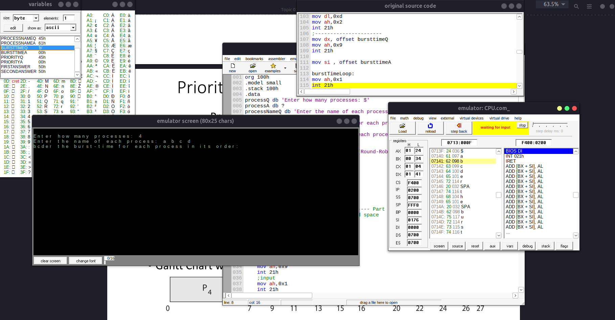

Slide 9
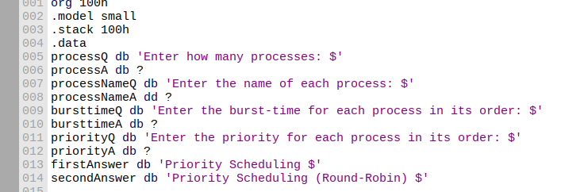
Make the size double word(d)[4bytes] instead of byte(b)[1byte]
It will be sufficient just for 4 letters

Slide 10

So should we limit our input to 4 process or making our variable bigger in size

Slide 11
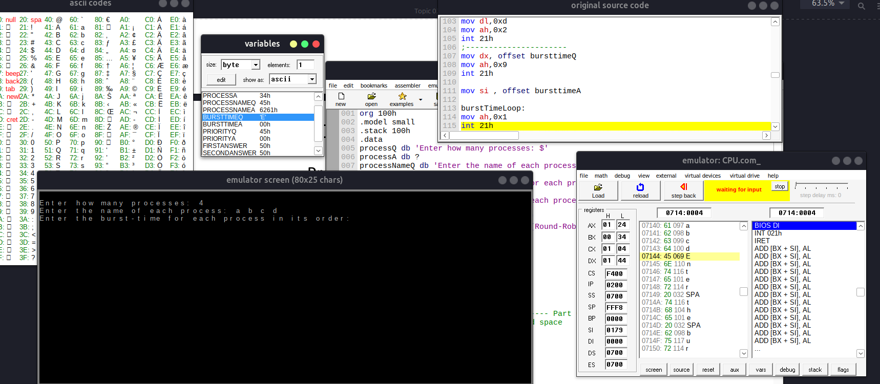

Slide 12
Problem 4

Slide 13
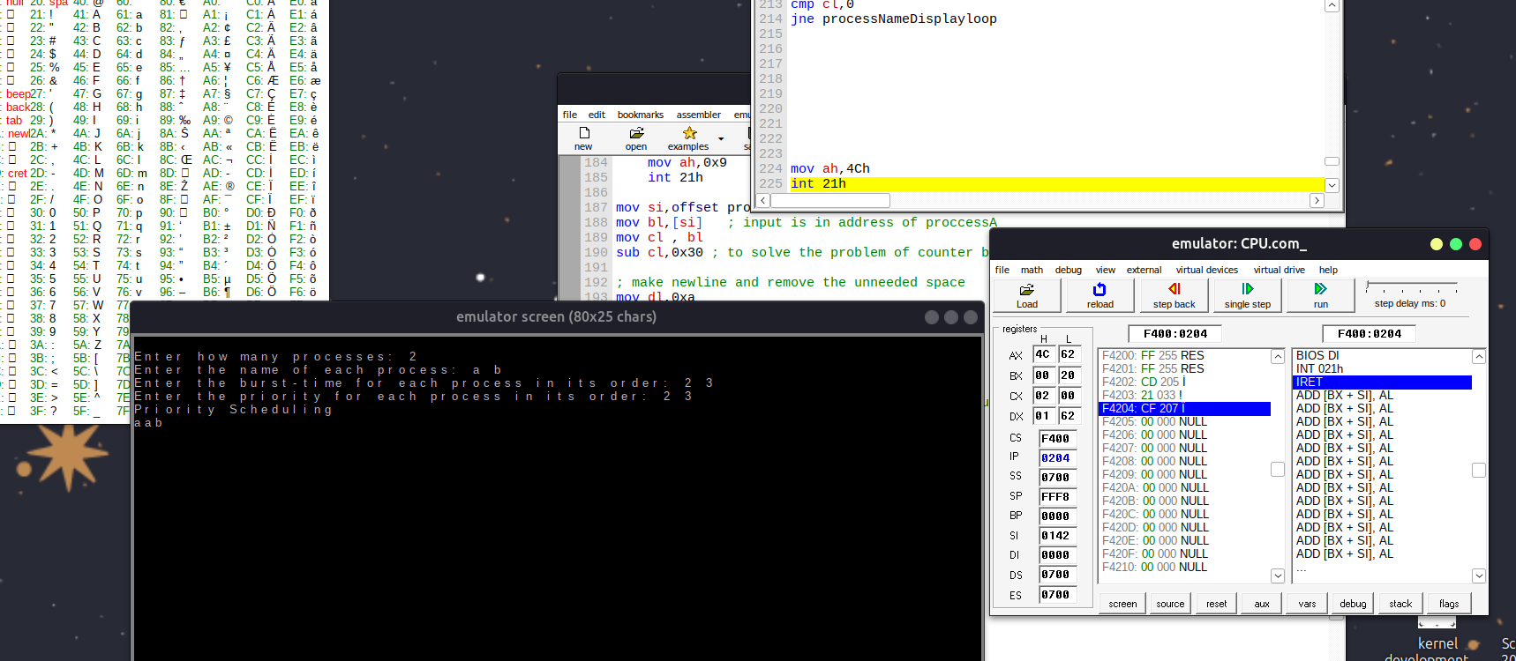

Slide 14

Two inputs with three outputs whyyyyyyyyyyyyyyyyyyyy

Slide 15
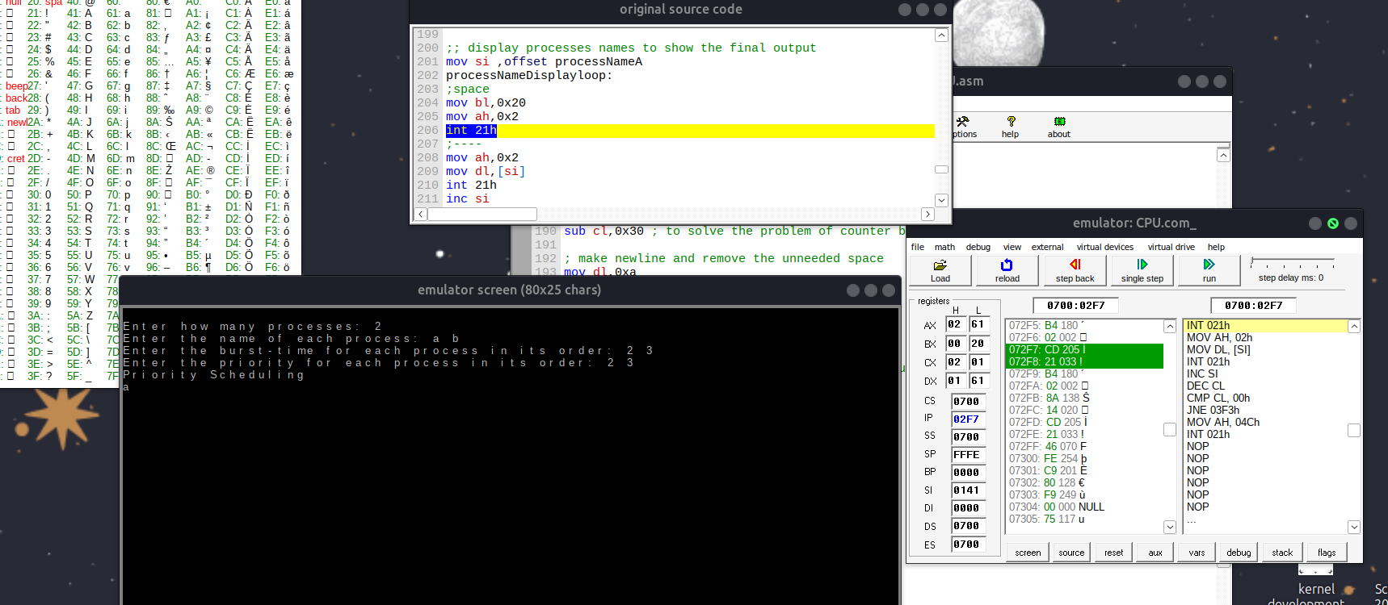
With debugging we found out that the problem is in these three lines of code

Slide 16
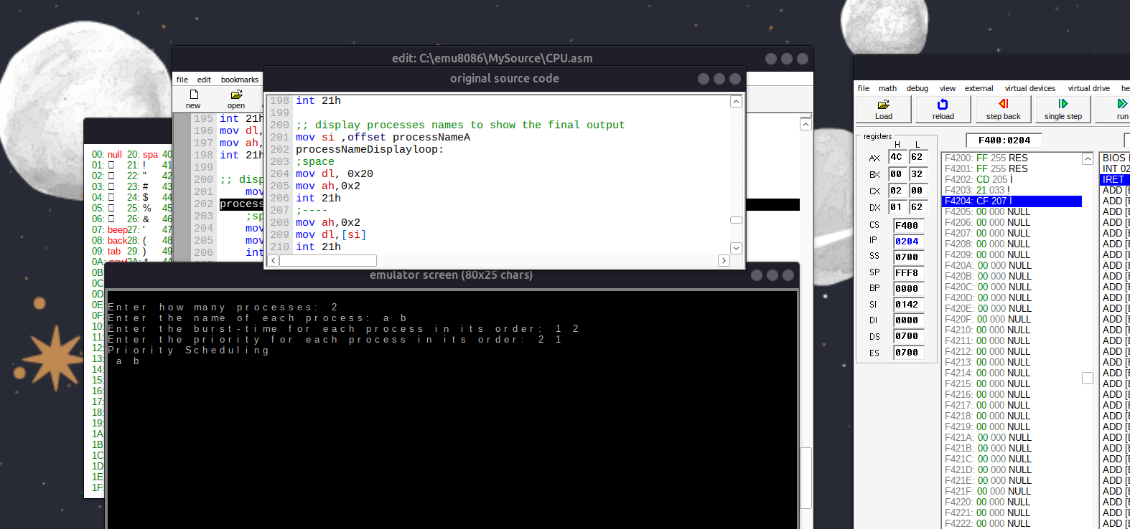
Problem is in (mov bl, 0x20) we neet to correct it to (mov dl, 0x20)

Slide 17

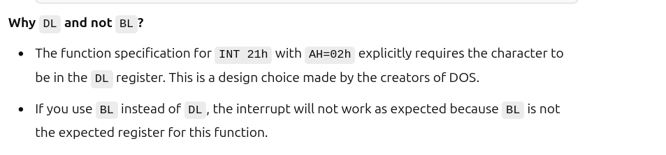
Problem is in (mov bl, 0x20) so we correct it to (mov dl, 0x20)
Our loved question whyyyyyyyyyyyyyyyyyyyyyy
I am tired of searching I will ask CHATGPT

Slide 18
Problem 5

Slide 19
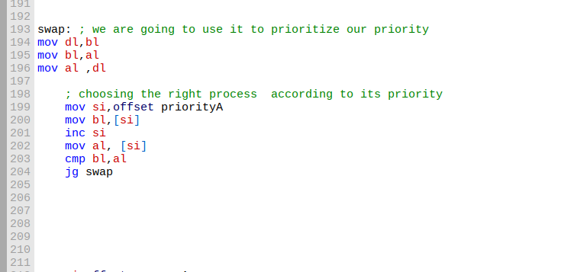
We here are facing another problem
Offset we can demonstrate it later but I will use lea to make it easy for me but it will take much time
To compile

